Slide 1
Transition to ‘By Division’ Elections
Pre-Map Hearing #1
June 21, 2023

Slide 2
Overview
Discuss need to transition from at-large to by-division elections
Review protected classes and communities of interest
Review Santa Ynez CSD demographics
Process to create election divisions
Ways to provide input
Q&A

Slide 3
Need for Establishing Divisions
California Voting Rights Act
Signed into law in 2002
Helps protect minorities from racially polarized voting practices such as vote dilution
Provides more opportunity for protected classes to legally challenge election practices
Recent challenges or ‘notices of intent to challenge’ have been seen in the area
Moving to by division elections can help avoid a legal challenge and costly fees

Slide 4
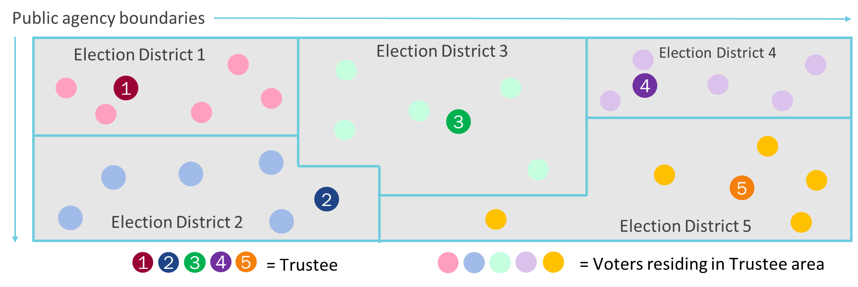
Directors
Voters Residing in Divisions

Slide 5
Tentative Process/Timeline
First Pre-Map Hearing
June 21, 2023 (Tonight)
Second Pre-Map Hearing
July 19, 2023
First Map Consideration Hearing
September 20, 2023
Second Map Consideration Hearing
October 18, 2023
Final Map Adoption Hearing and Approval
November 15, 2023

Slide 6
Introduction to Districting
Federal Laws
Traditional Districting Principles
Federal Voting Rights Act (1965)
Equal Population
No Racial Vote Dilution
Packing & Cracking
Be composed of contiguous territory
Be geographically compact
Preserve “identifiable communities of interest”
Be bounded by natural and/or man-made boundaries
Minimize voters shifted to different election years
Preserve the core of existing election areas
Notes:
Redistricting is when we redraw districts so each has the same number of residents

Slide 7
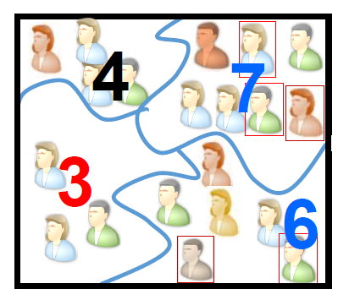
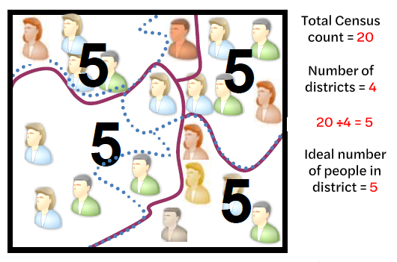
Over time, districts become uneven in population…
Every ten years, the district lines must be redrawn to make each district even in the number of people again

Slide 8
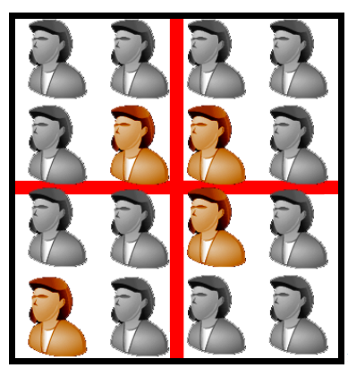
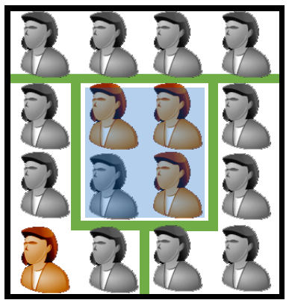
Minorities make up only ¼ in all 4 districts
Minorities make up ¾ of this district
If a majority can be drawn, the Voting Rights Act requires it

Slide 9
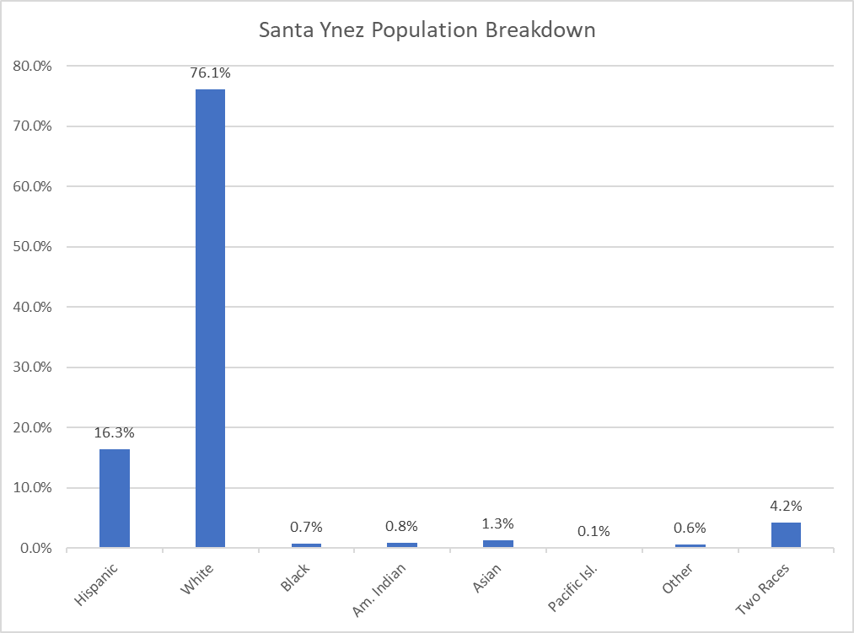
Santa Ynez CSD Demographics
Current 2020 Population - 3,300
660 /division
Ethnic Population
Hispanic (540)
Citizen Voting Age Population (CVAP)
Growth rate

Slide 10
Process for Creating Election Divisions
Review of census and election precinct data
Based on public input and collected data, different map options will be created for review and consideration by the District Board
Public hearings will be held to determine which map will best represent communities within the District
Final map adopted by the Board of Directors at a public hearing
Pre-map meetings to gain public input on logical divisions and communities of interest

Slide 11
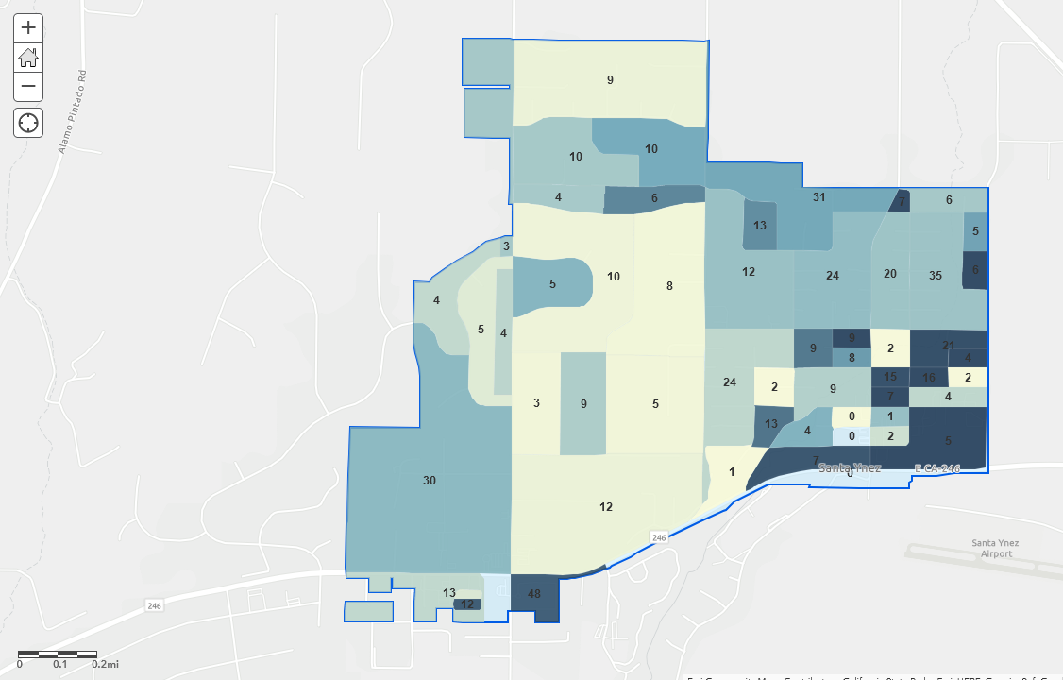
Simple Map Review Tool
Online Interactive Review Map
ESRI’s “ArcGIS Online” – similar to Google Maps in ease of use
Used to review, analyze and compare maps, not to create them

Slide 12
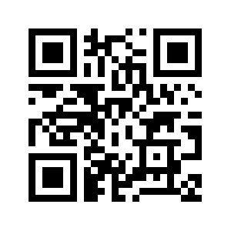
Ways to Provide Input
Online Map
Submit a comment or letter to the District
Communities of Interest
Draft map options
Questions regarding process
Participate in one of the public meetings
Call, email, snail mail, or drop by!

Slide 13
Questions?
Santa Ynez
Community Services District
1070 Faraday St, Santa Ynez, CA 93460
(805) 688-3008
Open Monday – Friday
8:30am to 5:00pm
https://www.sycsd.com/

